Slide 1
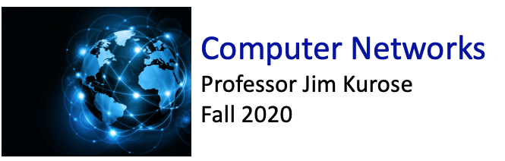

Class website: http://kurose.cslash.net
kurose@cs.umass.edu
Today (11/22/20):
week in review
  Link layer services (also SmartNIC)
  Multiple access
  LANs, addressing
  MPLS, (also EVPN vs VXLAN)
looking ahead

Slide 2








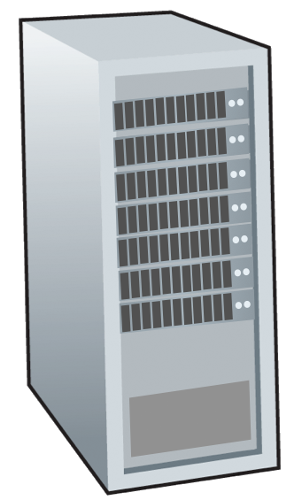







Link layer: introduction
terminology:
hosts and routers: nodes
communication channels that connect adjacent nodes along communication path: links
  wired
  wireless
  LANs
layer-2 packet: frame, encapsulates datagram
mobile network
national or global ISP
datacenter
network
link layer has responsibility of
transferring datagram from one node
to physically adjacent node over a link
enterprise
network

Slide 3
Link layer: context
datagram transferred by different link protocols over different links:
  e.g., WiFi on first link, Ethernet on next link
each link protocol provides different services
  e.g., may or may not provide reliable data transfer over link
transportation analogy:
trip from Princeton to Lausanne
  limo: Princeton to JFK
  plane: JFK to Geneva
  train: Geneva to Lausanne
tourist = datagram
transport segment = communication link
transportation mode = link-layer protocol
travel agent = routing algorithm

Slide 4


Link layer: services
framing, link access:
  encapsulate datagram into frame, adding header, trailer
  channel access if shared medium
  “MAC” addresses in frame headers identify source, destination (different from IP address!)
reliable delivery between adjacent nodes
  we already know how to do this!
  seldom used on low bit-error links
  wireless links: high error rates
    Q: why both link-level and end-end reliability?
…
…

Slide 5
Link layer: services (more)
flow control:
  pacing between adjacent sending and receiving nodes
error detection:
  errors caused by signal attenuation, noise.
  receiver detects errors, signals retransmission, or drops frame
error correction:
  receiver identifies and corrects bit error(s) without retransmission
half-duplex and full-duplex:
  with half duplex, nodes at both ends of link can transmit, but not at same time
…
…

Slide 6
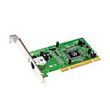
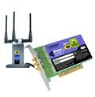

Where is the link layer implemented?
in each-and-every host
link layer implemented in network interface card (NIC) or on a chip
  Ethernet, WiFi card or chip
  implements link, physical layer
attaches into host’s system buses
combination of hardware, software, firmware
application
transport
network
link
cpu
memory
host bus
(e.g., PCI)
controller
link
physical
physical
network interface

Slide 7
Interfaces communicating
application
transport
network
link
application
transport
network
link
cpu
memory
memory
CPU
datagram
link_{h}
datagram
controller
controller
datagram
link_{h}
link
physical
link
physical
physical
physical
sending side:
encapsulates datagram in frame
adds error checking bits, reliable data transfer, flow control, etc.
receiving side:
looks for errors, reliable data transfer, flow control, etc.
extracts datagram, passes to upper layer at receiving side

Slide 8
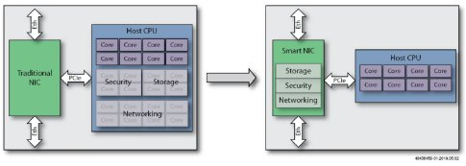
SmartNICs
Offloading network functions:
from host CPU to bus-connected device
ACM SIGArch: “SmartNICs: old idea, new times: The idea of adding programmable hardware to the NIC was actively researched in the early 2000s with the introduction of Network Processors, such as Intel’s IXP series”
Intel’s Chief Software Architect for IXP family of network processors (1999-2004): R. Yavatkar

Slide 9




Multiple access links, protocols
two types of “links”:
point-to-point
  point-to-point link between Ethernet switch, host
  PPP for dial-up access
broadcast (shared wire or medium)
  old-school Ethernet
  upstream HFC in cable-based access network
  802.11 wireless LAN, 4G/4G. satellite
shared wire (e.g.,
cabled Ethernet)
shared radio: 4G/5G
shared radio: WiFi
shared radio: satellite
humans at a cocktail party
(shared air, acoustical)

Slide 10
Multiple access protocols
single shared broadcast channel
two or more simultaneous transmissions by nodes: interference
  collision if node receives two or more signals at the same time
multiple access protocol
distributed algorithm that determines how nodes share channel, i.e., determine when node can transmit
communication about channel sharing must use channel itself!
  no out-of-band channel for coordination

Slide 11
An ideal multiple access protocol
given: multiple access channel (MAC) of rate R bps
desiderata:
  1. when one node wants to transmit, it can send at rate R.
  2. when M nodes want to transmit, each can send at average rate R/M
  3. fully decentralized:
    no special node to coordinate transmissions
    no synchronization of clocks, slots
  4. simple

Slide 12
MAC protocols: taxonomy
three broad classes:
channel partitioning
  divide channel into smaller “pieces” (time slots, frequency, code)
  allocate piece to node for exclusive use
random access
  channel not divided, allow collisions
  “recover” from collisions
“taking turns”
  nodes take turns, but nodes with more to send can take longer turns

Slide 13
Channel partitioning MAC protocols: TDMA
TDMA: time division multiple access
access to channel in “rounds”
each station gets fixed length slot (length = packet transmission time) in each round
unused slots go idle
example: 6-station LAN, 1,3,4 have packets to send, slots 2,5,6 idle
6-slot
frame
6-slot
frame
1
3
4
1
3
4

Slide 14
Channel partitioning MAC protocols: FDMA
FDMA: frequency division multiple access
channel spectrum divided into frequency bands
each station assigned fixed frequency band
unused transmission time in frequency bands go idle
example: 6-station LAN, 1,3,4 have packet to send, frequency bands 2,5,6 idle
time
frequency bands
FDM cable

Slide 15
Random access protocols
when node has packet to send
  transmit at full channel data rate R
  no a priori coordination among nodes
two+ sending nodes: “collision”
random access protocol specifies:
  when to send
  how to detect collisions
  how to recover from collisions (e.g., via delayed retransmissions)
examples of random access MAC protocols:
  ALOHA
  CSMA, CSMA/CD, CSMA/CA

Slide 16
CSMA (carrier sense multiple access)
simple CSMA: listen before transmit:
  if channel sensed idle: transmit entire frame
  if channel sensed busy: defer transmission
human analogy: don’t interrupt others!
CSMA/CD: CSMA with collision detection
  collisions detected within short time
  colliding transmissions aborted, reducing channel wastage
  collision detection easy in wired, difficult with wireless
human analogy: the polite conversationalist

Slide 17
“Taking turns” MAC protocols
polling:
centralized controller uses polling messages to “invite” client nodes to transmit in turn
protocol needed for client devices to join/leave network
concerns:
  polling overhead
  access latency (wait for turn)
  single point of failure
Bluetooth uses polling
1
data
poll
poll
2
centralized controller
3
data
4
client devices

Slide 18
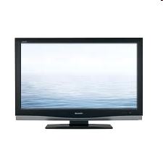
Cable access network: FDM, TDM and random access!
Internet frames, TV channels, control transmitted
downstream at different frequencies
cable headend
…
CMTS
…
splitter
cable
modem
ISP
cable modem
termination system
DOCSIS: Data Over Cable Service Interface Specification
multiple downstream (broadcast) FDM channels: up to 1.6 Gbps/channel
  single CMTS transmits into downstream channels
multiple upstream FDM channels (up to 1 Gbps/channel)
  multiple homes transmit into upstream channels

Slide 19
Cable access network:
MAP frame for
Interval [t1, t2]
CMTS
Downstream channel i
Upstream channel j
cable headend
t₁
t₂
Residences with cable modems
Minislots containing
minislots request frames
Assigned minislots containing cable modem
upstream data frames
upstream channel divided into TDM slots
  some upstream slots assigned to nodes in downstream MAP frame
  other upstream slots accessed via random access with binary backoff

Slide 20
MAC addresses
each interface on LAN
has unique 48-bit MAC address
has a locally unique 32-bit IP address (as we’ve seen)
137.196.7.78
1A-2F-BB-76-09-AD
LAN
(wired or wireless)
137.196.7/24
71-65-F7-2B-08-53
58-23-D7-FA-20-B0
137.196.7.23
137.196.7.14
0C-C4-11-6F-E3-98
137.196.7.88

Slide 21
ARP: address resolution protocol
Question: how to determine interface’s MAC address, knowing its IP address?
ARP table: each IP node (host, router) on LAN has table
ARP
137.196.7.78
  IP/MAC address mappings for some LAN nodes:
< IP address; MAC address; TTL>
  TTL (Time To Live): time after which address mapping will be forgotten (typically 20 min)
1A-2F-BB-76-09-AD
ARP
ARP
LAN
71-65-F7-2B-08-53
58-23-D7-FA-20-B0
137.196.7.23
137.196.7.14
ARP
0C-C4-11-6F-E3-98
137.196.7.88

Slide 22
ARP protocol in action
example: A wants to send datagram to B
  B’s MAC address not in A’s ARP table, so A uses ARP to find B’s MAC address
A broadcasts ARP query, containing B's IP addr
  destination MAC address = FF-FF-FF-FF-FF-FF
  all nodes on LAN receive ARP query
1
Ethernet frame (sent to FF-FF-FF-FF-FF-FF)
C
Source MAC: 71-65-F7-2B-08-53
Source IP: 137.196.7.23
Target IP address: 137.196.7.14
…
ARP table in A
IP addr
MAC addr
TTL
TTL
A
B
1
71-65-F7-2B-08-53
58-23-D7-FA-20-B0
137.196.7.23
137.196.7.14
D

Slide 23
ARP protocol in action
example: A wants to send datagram to B
  B’s MAC address not in A’s ARP table, so A uses ARP to find B’s MAC address
ARP message into Ethernet frame (sent to 71-65-F7-2B-08-53)
C
Target IP address: 137.196.7.14
Target MAC address:
58-23-D7-FA-20-B0
…
ARP table in A
IP addr
MAC addr
TTL
TTL
A
B
2
71-65-F7-2B-08-53
58-23-D7-FA-20-B0
137.196.7.23
137.196.7.14
2
B replies to A with ARP response, giving its MAC address
D

Slide 24
ARP protocol in action
example: A wants to send datagram to B
  B’s MAC address not in A’s ARP table, so A uses ARP to find B’s MAC address
C
ARP table in A
IP addr
MAC addr
TTL
TTL
A
B
137.196.
7.14
58-23-D7-FA-20-B0
500
71-65-F7-2B-08-53
58-23-D7-FA-20-B0
137.196.7.23
137.196.7.14
3
A receives B’s reply, adds B entry into its local ARP table
D

Slide 25

Routing to another subnet: addressing
walkthrough: sending a datagram from A to B via R
  focus on addressing – at IP (datagram) and MAC layer (frame) levels
  assume that:
    A knows B’s IP address
    A knows IP address of first hop router, R (how?)
    A knows R’s MAC address (how?)
A
R
B
111.111.111.111
74-29-9C-E8-FF-55
222.222.222.222
49-BD-D2-C7-56-2A
222.222.222.220
1A-23-F9-CD-06-9B
111.111.111.112
111.111.111.110
CC-49-DE-D0-AB-7D
E6-E9-00-17-BB-4B
222.222.222.221
88-B2-2F-54-1A-0F

Slide 26
Routing to another subnet: addressing
A creates IP datagram with IP source A, destination B
A creates link-layer frame containing A-to-B IP datagram
  R's MAC address is frame’s destination
MAC src: 74-29-9C-E8-FF-55
MAC dest: E6-E9-00-17-BB-4B
IP
Eth
Phy
IP src: 111.111.111.111
IP dest: 222.222.222.222
A
R
B
111.111.111.111
74-29-9C-E8-FF-55
222.222.222.222
49-BD-D2-C7-56-2A
222.222.222.220
1A-23-F9-CD-06-9B
111.111.111.112
111.111.111.110
CC-49-DE-D0-AB-7D
E6-E9-00-17-BB-4B
222.222.222.221
88-B2-2F-54-1A-0F

Slide 27
Routing to another subnet: addressing
frame sent from A to R
frame received at R, datagram removed, passed up to IP
MAC src: 74-29-9C-E8-FF-55
MAC dest: E6-E9-00-17-BB-4B
IP src: 111.111.111.111
IP dest: 222.222.222.222
IP
Eth
Phy
IP src: 111.111.111.111
IP dest: 222.222.222.222
IP
Eth
Phy
A
R
B
111.111.111.111
74-29-9C-E8-FF-55
222.222.222.222
49-BD-D2-C7-56-2A
222.222.222.220
1A-23-F9-CD-06-9B
111.111.111.112
111.111.111.110
CC-49-DE-D0-AB-7D
E6-E9-00-17-BB-4B
222.222.222.221
88-B2-2F-54-1A-0F

Slide 28
Routing to another subnet: addressing
R determines outgoing interface, passes datagram with IP source A, destination B to link layer
R creates link-layer frame containing A-to-B IP datagram. Frame destination address: B's MAC address
MAC src: 1A-23-F9-CD-06-9B
MAC dest: 49-BD-D2-C7-56-2A
IP
Eth
Phy
IP src: 111.111.111.111
IP dest: 222.222.222.222
A
R
B
111.111.111.111
74-29-9C-E8-FF-55
222.222.222.222
49-BD-D2-C7-56-2A
222.222.222.220
1A-23-F9-CD-06-9B
111.111.111.112
111.111.111.110
CC-49-DE-D0-AB-7D
E6-E9-00-17-BB-4B
222.222.222.221
88-B2-2F-54-1A-0F

Slide 29
Routing to another subnet: addressing
R determines outgoing interface, passes datagram with IP source A, destination B to link layer
R creates link-layer frame containing A-to-B IP datagram. Frame destination address: B's MAC address
MAC src: 1A-23-F9-CD-06-9B
MAC dest: 49-BD-D2-C7-56-2A
transmits link-layer frame
IP
Eth
Phy
IP
Eth
Phy
IP src: 111.111.111.111
IP dest: 222.222.222.222
A
R
B
111.111.111.111
74-29-9C-E8-FF-55
222.222.222.222
49-BD-D2-C7-56-2A
222.222.222.220
1A-23-F9-CD-06-9B
111.111.111.112
111.111.111.110
CC-49-DE-D0-AB-7D
E6-E9-00-17-BB-4B
222.222.222.221
88-B2-2F-54-1A-0F

Slide 30
Routing to another subnet: addressing
B receives frame, extracts IP datagram destination B
B passes datagram up protocol stack to IP
IP src: 111.111.111.111
IP dest: 222.222.222.222
IP
Eth
Phy
IP
Eth
Phy
A
R
B
111.111.111.111
74-29-9C-E8-FF-55
222.222.222.222
49-BD-D2-C7-56-2A
222.222.222.220
1A-23-F9-CD-06-9B
111.111.111.112
111.111.111.110
CC-49-DE-D0-AB-7D
E6-E9-00-17-BB-4B
222.222.222.221
88-B2-2F-54-1A-0F

Slide 31

Easy:
SmartNIC
MPLS
Network slicing
VNF versus NFV
EVPN/VXLAN
Leaf-spine (datacenter)
A bit of prep:
SR IOV
SNAT
XMPP
DPDK

