Slide 1
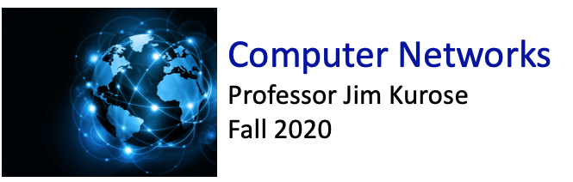

Class website: http://kurose.cslash.net
kurose@cs.umass.edu
Today (12/8/20):
week in review
  EVPN, VXLANs
  MPLS
  Data center networks
  Wireless networks
looking ahead

Slide 2

Switches vs. routers
application
transport
network
link
physical
both are store-and-forward:
routers: network-layer devices (examine network-layer headers)
switches: link-layer devices (examine link-layer headers)
datagram
frame
link
physical
frame
switch
network
link
physical
datagram
both have forwarding tables:
routers: compute tables using routing algorithms, IP addresses
switches: learn forwarding table using flooding, learning, MAC addresses
frame
application
transport
network
link
physical

Slide 3
UMass Campus Network
Protocols
Link Speeds
to off campus
eBGP
10G;
100G pending
border
inter-domain
routing
border
iBGP
IS-IS
40G & 100G
Core
core
intra-domain
routing
IS-IS
40G
Agg1
Agg2
Agg3
Agg4
WiFi
...
...
...
...
...
firewall
data center
building
closets
Wireless
Controller
Wireless
Controller
layer-2
switching
Ethernet
10G & 1G

Slide 4
Ethernet frame structure
type
preamble
dest.
address
source
address
data (payload)
CRC
addresses: 6-byte source, destination MAC addresses
  if adapter receives frame with matching destination address, or with broadcast address (e.g., ARP packet), it passes data in frame to network layer protocol
  otherwise, adapter discards frame
type: indicates higher layer protocol
  mostly IP but others possible
  used to demultiplex up at receiver
CRC: cyclic redundancy check at receiver
  error detected: frame is dropped

Slide 5
Port-based VLANs
port-based VLAN: switch ports grouped (by switch management software) so that single physical switch ……
Virtual Local Area Network (VLAN)
1
7
9
15
switch(es) supporting VLAN capabilities can be configured to define multiple virtual LANS over single physical LAN infrastructure.
2
8
10
16
…
…
EE (VLAN ports 1-8)
CS (VLAN ports 9-15)
… operates as multiple virtual switches
1
7
9
15
2
8
10
16
…
…
EE (VLAN ports 1-8)
CS (VLAN ports 9-15)

Slide 6
VLANS spanning multiple switches
1
7
9
15
1
3
5
7
2
8
10
16
16
2
4
6
8
…
…
…
EE (VLAN ports 1-8)
CS (VLAN ports 9-15)
Ports 2,3,5 belong to EE VLAN
Ports 4,6,7,8 belong to CS VLAN
trunk port: carries frames between VLANS defined over multiple physical switches
  frames forwarded within VLAN between switches can’t be vanilla 802.1 frames (must carry VLAN ID info)
  802.1q protocol adds/removed additional header fields for frames forwarded between trunk ports

Slide 7
802.1Q VLAN frame format
type
preamble
dest.
address
source
address
data (payload)
CRC
802.1 Ethernet frame
type
preamble
dest.
address
source
address
data (payload)
CRC
802.1Q frame
2-byte Tag Protocol Identifier
(value: 81-00)
Recomputed
CRC
Tag Control Information
(12 bit VLAN ID field, 3 bit priority field like IP TOS)

Slide 8
EVPN: Ethernet VPNs (aka VXLANs)
7
9
15
1
5
1
3
7
2
8
10
16
IP
datagram
Ethernet
frame
16
2
4
6
8
…
…
…
Sunnyvale
data center
Bangalore
data center
Ethernet
Layer-2 Ethernet switches logically connected to each other (e.g., using IP as an underlay)
  Ethernet frames carried within IP datagrams between sites
  “tunneling scheme to overlay Layer 2 networks on top of Layer 3 networks ... runs over the existing networking infrastructure and provides a means to "stretch" a Layer 2 network.” [RFC 7348]

Slide 9
Multiprotocol label switching (MPLS)
goal: high-speed IP forwarding among network of MPLS-capable routers, using fixed length label (instead of shortest prefix matching)
  faster lookup using fixed length identifier
  borrowing ideas from Virtual Circuit (VC) approach
  but IP datagram still keeps IP address!
Ethernet
header
remainder of Ethernet frame, including IP header with IP source, destination addresses
MPLS header
remainder of Ethernet frame, including IP header with IP source, destination addresses
label
Exp
S
TTL
20
3
1
5

Slide 10
MPLS capable routers
a.k.a. label-switched router
forward packets to outgoing interface based only on label value (don’t inspect IP address)
  MPLS forwarding table distinct from IP forwarding tables
flexibility: MPLS forwarding decisions can differ from those of IP
  use destination and source addresses to route flows to same destination differently (traffic engineering)
  re-route flows quickly if link fails: pre-computed backup paths

Slide 11
MPLS versus IP paths
R6
D
IP router
R4
R3
R5
A
R2
IP routing: path to destination determined by destination address alone

Slide 12
MPLS versus IP paths
IP/MPLS entry router (R4) can use different MPLS routes to A based, e.g., on IP source address or other fields
R6
D
IP router
R4
R3
R5
IP/MPLS router
A
R2
R1
IP routing: path to destination determined by destination address alone
MPLS routing: path to destination can be based on source and destination address
  flavor of generalized forwarding (MPLS 10 years earlier)
  fast reroute: precompute backup routes in case of link failure

Slide 13
MPLS forwarding tables
in out out
label label dest interface
10 A 0
in out out
label label dest interface
12 D 0
8 A 1
10 6 A 1
12 9 D 0
R6
0
0
D
1
1
R4
R3
R5
0
0
A
R2
R1
in out out
label label dest interface
in out out
label label dest interface
8 6 A 0
6 - A 0

Slide 14
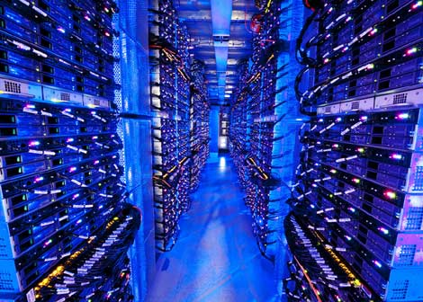
Datacenter networks
10’s to 100’s of thousands of hosts, often closely coupled, in close proximity:
  e-business (e.g. Amazon)
  content-servers (e.g., YouTube, Akamai, Apple, Microsoft)
  search engines, data mining (e.g., Google)
challenges:
  multiple applications, each serving massive numbers of clients
  reliability
  managing/balancing load, avoiding processing, networking, data bottlenecks
Inside a 40-ft Microsoft container, Chicago data center

Slide 15
Datacenter networks: network elements
Border routers
connections outside datacenter
Tier-1 switches
connecting to ~16 T-2s below
Tier-2 switches
connecting to ~16 TORs below
…
…
…
…
Top of Rack (TOR) switch
one per rack
40-100Gbps Ethernet to blades
…
…
…
…
Server racks
20- 40 server blades: hosts

Slide 16
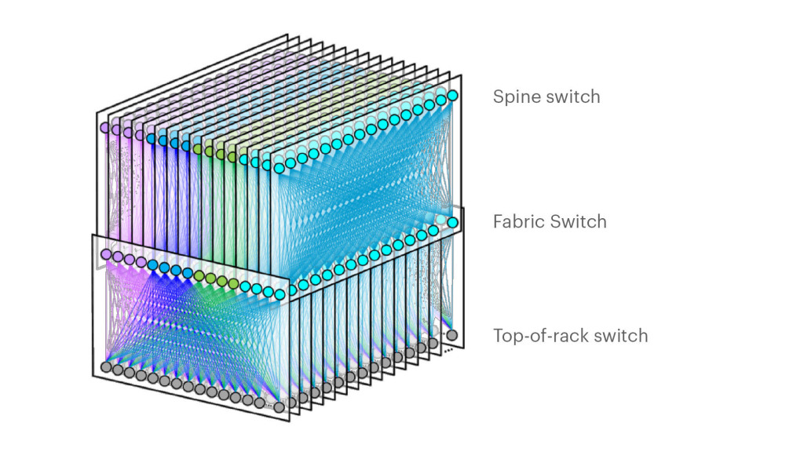
Datacenter networks: network elements
Facebook F16 data center network topology:
https://engineering.fb.com/data-center-engineering/f16-minipack/ (posted 3/2019)

Slide 17
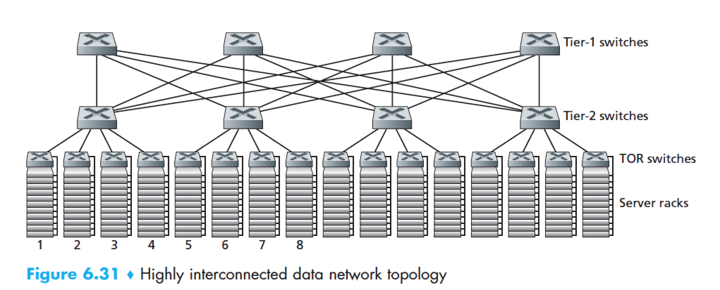
Datacenter networks: multipath
rich interconnection among switches, racks:
  increased throughput between racks (multiple routing paths possible)
  increased reliability via redundancy
9
10
11
12
13
14
15
16
two disjoint paths highlighted between racks 1 and 11

Slide 18
Datacenter networks: application-layer routing
Internet
load balancer: application-layer routing
receives external client requests
directs workload within data center
Load
balancer
…
…
…
…
returns results to external client (hiding data center internals from client)
…
…
…
…

Slide 19
Datacenter networks: protocol innovations
link layer:
  RoCE: remote DMA (RDMA) over Converged Ethernet
transport layer:
  ECN (explicit congestion notification) used in transport-layer congestion control (DCTCP, DCQCN)
  experimentation with hop-by-hop (backpressure) congestion control
routing, management:
  SDN widely used within/among organizations’ datacenters
  place related services, data as close as possible (e.g., in same rack or nearby rack) to minimize tier-2, tier-1 communication

Slide 20
Wireless and Mobile Networks: context
more wireless (mobile) phone subscribers than fixed (wired) phone subscribers (10-to-1 in 2019)!
more mobile-broadband-connected devices than fixed-broadband-connected devices devices (5-1 in 2019)!
  4G/5G cellular networks now embracing Internet protocol stack, including SDN
two important (but different) challenges
  wireless: communication over wireless link
  mobility: handling the mobile user who changes point of attachment to network

Slide 21



















Elements of a wireless network
wired network
infrastructure

Slide 22





Elements of a wireless network
wireless hosts
laptop, smartphone, IoT
run applications
may be stationary (non-mobile) or mobile
  wireless does not always mean mobility!
wired network
infrastructure

Slide 23

Elements of a wireless network
base station
typically connected to wired network
relay - responsible for sending packets between wired network and wireless host(s) in its “area”
  e.g., cell towers, 802.11 access points
wired network
infrastructure

Slide 24
Elements of a wireless network
wireless link
typically used to connect mobile(s) to base station, also used as backbone link
multiple access protocol coordinates link access
various transmission rates and distances, frequency bands
wired network
infrastructure

Slide 25
Characteristics of selected wireless links
14 Gbps
802.11ax
10 Gbps
5G
3.5 Gbps
802.11ac
802.11 af,ah
600 Mbps
802.11n
4G LTE
54 Mbps
802.11g
11 Mbps
802.11b
2 Mbps
Bluetooth
Indoor
Outdoor
Midrange
outdoor
Long range
outdoor
10-30m
50-200m
200m-4Km
4Km-15Km

Slide 26



802.11: Channels, association
spectrum divided into channels at different frequencies
  AP admin chooses frequency for AP
  interference possible: channel can be same as that chosen by neighboring AP!
arriving host: must associate with an AP
  scans channels, listening for beacon frames containing AP’s name (SSID) and MAC address
  selects AP to associate with
  then may perform authentication [Chapter 8]
  then typically run DHCP to get IP address in AP’s subnet
BSS

Slide 27




IEEE 802.11: multiple access
avoid collisions: 2⁺ nodes transmitting at same time
802.11: CSMA - sense before transmitting
  don’t collide with detected ongoing transmission by another node
802.11: no collision detection!
  difficult to sense collisions: high transmitting signal, weak received signal due to fading
  can’t sense all collisions in any case: hidden terminal, fading
  goal: avoid collisions: CSMA/CollisionAvoidance
A
B
C
C
B
A’s signal
strength
C’s signal
strength
A
space

Slide 28
IEEE 802.11 MAC Protocol: CSMA/CA
802.11 sender
1 if sense channel idle for DIFS then
  transmit entire frame (no CD)
sender
receiver
DIFS
2 if sense channel busy then
  start random backoff time
  timer counts down while channel idle
  transmit when timer expires
  if no ACK, increase random backoff interval, repeat 2
data
SIFS
802.11 receiver
if frame received OK
return ACK after SIFS (ACK needed due to hidden terminal problem)
ACK

Slide 29

Collision Avoidance: RTS-CTS exchange
A
B
AP
RTS(A)
RTS(B)
reservation collision
RTS(A)
CTS(A)
CTS(A)
time
DATA (A)
defer
ACK(A)
ACK(A)

Slide 30
802.11 frame: addressing
2
2
6
6
6
2
6
0 - 2312
4
frame
control
duration
address
1
address
2
address
3
seq
control
address
4
payload
CRC
Address 1: MAC address of wireless host or AP to receive this frame
Address 4: used only in ad hoc mode
Address 3: MAC address of router interface to which AP is attached
Address 2: MAC address
of wireless host or AP
transmitting this frame

Slide 31
802.11 frame: addressing
Internet
H1
R1
802.3 Ethernet frame
R1 MAC addr
H2 MAC addr
MAC dest addr
MAC source addr
AP MAC addr
H1 MAC addr
R1 MAC addr
address 1
address 2
address 3
802.11 WiFi frame

Slide 32

Looking ahead:
4G LTE
discussion

Slide 33
Easy:
SmartNIC
MPLS
Network slicing
VNF versus NFV
EVPN/VXLAN
Leaf-spine (datacenter)
A bit of prep:
SR IOV
SNAT
XMPP
DPDK

