Slide 1


Today (9/22/20):
week in review
Wireshark (time-permitting)

Slide 2
What we covered this past week
application-layer principles:
  distributed interacting processes; client-server, P2P paradigms;
  sockets, transport layer service – TCP, UDP
Web and HTTP
  “stateless-ness”; persistent (1.1), non-persistent (1.0); HTTP requests (GET), responses; cookies
  Web caches, conditional GET, HTTP/2
Domain Name system (DNS)
  DNS hierarchy, query resolution
Oh .... also email (SMTP)

Slide 3


HTTP overview
HTTP: hypertext transfer protocol
Web’s application-layer protocol
client/server model:
  client: browser that requests, receives, (using HTTP protocol) and “displays” Web objects
  server: Web server sends (using HTTP protocol) objects in response to requests
HTTP request
PC running
Firefox browser
HTTP response
HTTP request
server running
Apache Web
server
HTTP response
iPhone running
Safari browser

Slide 4
HTTP overview (continued)
HTTP uses TCP:
client initiates TCP connection (creates socket) to server, port 80
server accepts TCP connection from client
HTTP messages (application-layer protocol messages) exchanged between browser (HTTP client) and Web server (HTTP server)
TCP connection closed
HTTP is “stateless”
server maintains no information about past client requests
aside
protocols that maintain “state” are complex!
past history (state) must be maintained
if server/client crashes, their views of “state” may be inconsistent, must be reconciled

Slide 5
HTTP request message
two types of HTTP messages: request, response
HTTP request message:
  ASCII (human-readable format)
carriage return character
request line (GET, POST,
HEAD commands)
line-feed character
GET /index.html HTTP/1.1\r\n
Host: www-net.cs.umass.edu\r\n
User-Agent: Mozilla/5.0 (Macintosh; Intel Mac OS X 10.15; rv:80.0) Gecko/20100101 Firefox/80.0 \r\n
Accept: text/html,application/xhtml+xml\r\n
Accept-Language: en-us,en;q=0.5\r\n
Accept-Encoding: gzip,deflate\r\n
Connection: keep-alive\r\n
\r\n
header
lines
carriage return, line feed at start of line indicates end of header lines
* Check out the online interactive exercises for more examples: http://gaia.cs.umass.edu/kurose_ross/interactive/

Slide 6
HTTP response message
status line (protocol
status code status phrase)
HTTP/1.1 200 OK
Date: Tue, 08 Sep 2020 00:53:20 GMT
Server: Apache/2.4.6 (CentOS) OpenSSL/1.0.2k-fips PHP/7.4.9 mod_perl/2.0.11 Perl/v5.16.3
Last-Modified: Tue, 01 Mar 2016 18:57:50 GMT
ETag: "a5b-52d015789ee9e"
Accept-Ranges: bytes
Content-Length: 2651
Content-Type: text/html; charset=UTF-8
\r\n
data data data data data ...
header
lines
data, e.g., requested
HTML file
* Check out the online interactive exercises for more examples: http://gaia.cs.umass.edu/kurose_ross/interactive/

Slide 7
Maintaining user/server state: cookies
client
server
ebay 8734
usual HTTP request msg
Amazon server
creates ID
1678 for user
cookie file
usual HTTP response
set-cookie: 1678
backend
database
create
entry
ebay 8734
amazon 1678
usual HTTP request msg
cookie: 1678
cookie-
specific
action
access
usual HTTP response msg
aside
cookies and privacy:
cookies permit sites to learn a lot about you on their site.
third party persistent cookies
one week later:
access
ebay 8734
amazon 1678
usual HTTP request msg
cookie: 1678
cookie-
specific
action
usual HTTP response msg
time
time
Notes:
t’

Slide 8

Web caches
Goal: satisfy client requests without involving origin server
user configures browser to point to a (local) Web cache
browser sends all HTTP requests to cache
  if object in cache: cache returns object to client
  else cache requests object from origin server, caches received object, then returns object to client
Web
cache
HTTP request
HTTP request
client
HTTP response
HTTP response
origin
server
HTTP request
HTTP response
client
Notes:
t’

Slide 9


Web caches (aka proxy servers)
Web cache acts as both client and server
  server for original requesting client
  client to origin server
Why Web caching?
reduce response time for client request
  cache is closer to client
reduce traffic on an institution’s access link
Internet is dense with caches
  enables “poor” content providers to more effectively deliver content
server tells cache about object’s allowable caching in response header:
Notes:
re: poor content providers – like in real-estate, location is everything. servers want to be close to clients.

Slide 10
Browser caching: Conditional GET
client
server
Goal: don’t send object if cache has up-to-date cached version
  no object transmission delay (or use of network resources)
client: specify date of cached copy in HTTP request
  If-modified-since: <date>
server: response contains no object if cached copy is up-to-date:
  HTTP/1.0 304 Not Modified
HTTP request msg
If-modified-since: <date>
object
not
modified
before
<date>
HTTP response
HTTP/1.0
304 Not Modified
HTTP request msg
If-modified-since: <date>
object
modified
after
<date>
HTTP response
HTTP/1.0 200 OK
<data>
Notes:
t’

Slide 11
HTTP/2
Key goal: decreased delay in multi-object HTTP requests
HTTP/3: coming soon (2021)
Key goal: built-in (https) security, even-more-improved multi-object HTTP request
Notes:
t’

Slide 12
DNS: Domain Name System
people: many identifiers:
  SSN, name, passport #
Internet hosts, routers:
  IP address (32 bit) - used for addressing datagrams
  “name”, e.g., cs.umass.edu - used by humans
Q: how to map between IP address and name, and vice versa ?
Domain Name System (DNS):
distributed database implemented in hierarchy of many name servers
application-layer protocol: hosts, DNS servers communicate to resolve names (address/name translation)
  note: core Internet function, implemented as application-layer protocol
  complexity at network’s “edge”

Slide 13

Thinking about the DNS
humongous distributed database:
~ billion records, each simple
handles many trillions of queries/day:
many more reads than writes
performance matters: almost every Internet transaction interacts with DNS - msecs count!
organizationally, physically decentralized:
millions of different organizations responsible for their records
“bulletproof”: reliability, security

Slide 14
DNS: a distributed, hierarchical database
Root DNS Servers
Root
…
…
.com DNS servers
.org DNS servers
.edu DNS servers
Top Level Domain
…
…
…
…
yahoo.com
DNS servers
amazon.com
DNS servers
pbs.org
DNS servers
nyu.edu
DNS servers
umass.edu
DNS servers
Authoritative
Client wants IP address for www.amazon.com; 1st approximation:
client queries root server to find .com DNS server
client queries .com DNS server to get amazon.com DNS server
client queries amazon.com DNS server to get IP address for www.amazon.com

Slide 15
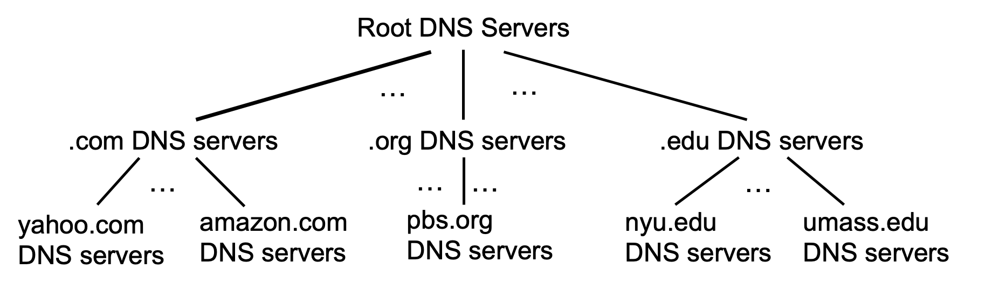
DNS: root name servers
official, contact-of-last-resort by name servers that can not resolve name

Slide 16
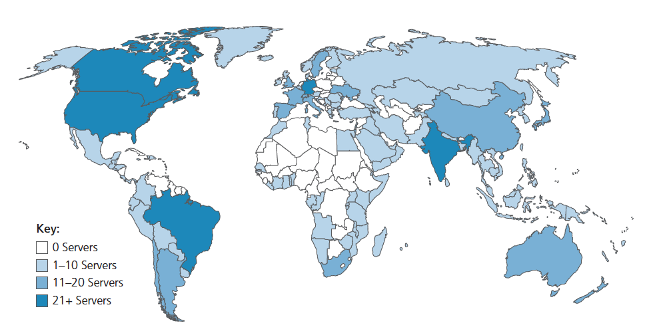
DNS: root name servers
official, contact-of-last-resort by name servers that can not resolve name
incredibly important Internet function
  Internet couldn’t function without it!
  DNSSEC – provides security (authentication, message integrity)
ICANN (Internet Corporation for Assigned Names and Numbers) manages root DNS domain
13 logical root name “servers” worldwide each “server” replicated many times (~200 servers in US)

Slide 17
Top-Level Domain, and authoritative servers
Top-Level Domain (TLD) servers:
  responsible for .com, .org, .net, .edu, .aero, .jobs, .museums, and all top-level country domains, e.g.: .cn, .uk, .fr, .ca, .jp
  Network Solutions: authoritative registry for .com, .net TLD
  Educause: .edu TLD
authoritative DNS servers:
  organization’s own DNS server(s), providing authoritative hostname to IP mappings for organization’s named hosts
  can be maintained by organization or service provider

Slide 18
Local DNS name servers
when host makes DNS query, it is sent to its local DNS server
  Local DNS server returns reply, answering:
    from its local cache of recent name-to-address translation pairs (possibly out of date!)
    forwarding request into DNS hierarchy for resolution
  each ISP has local DNS name server; to find yours:
    MacOS: % scutil --dns
    Windows: >ipconfig /all
local DNS server doesn’t strictly belong to hierarchy

Slide 19
DNS name resolution: iterated query
root DNS server
Example: host at engineering.nyu.edu wants IP address for gaia.cs.umass.edu
2
3
TLD DNS server
Iterated query:
contacted server replies with name of server to contact
“I don’t know this name, but ask this server”
1
4
8
5
requesting host at
engineering.nyu.edu
local DNS server
dns.nyu.edu
gaia.cs.umass.edu
7
6
authoritative DNS server
dns.cs.umass.edu

Slide 20


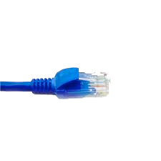
Let’s try out wireshark packet sniffer
application
(www browser,
email client)
packet
analyzer
application
OS
packet
capture
(pcap)
Transport (TCP/UDP)
Network (IP)
Link (Ethernet)
Physical
copy of all Ethernet frames sent/received

Slide 21

Looking ahead:
Sections 2.6, 2.7, 3.1, 3.2 in textbook
streaming video systems, socket programming, introduction to the transport layer

