Slide 1
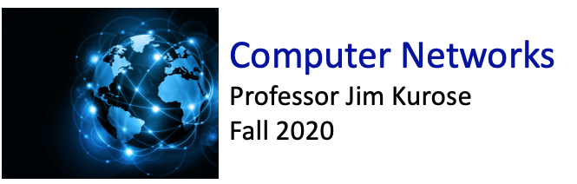

Class website: http://kurose.cslash.net
kurose@cs.umass.edu
Today (10/2/20):
week in review
Wireshark (time-permitting)
looking ahead

Slide 2
Week in review: DNS
DNS services:
hostname-to-IP-address translation
host aliasing
  canonical, alias names
mail server aliasing
load distribution
  replicated Web servers: many IP addresses correspond to one name
humongous distributed database:
~ billion records, each simple
handles many trillions of queries/day:
many more reads than writes
performance matters: almost every Internet transaction interacts with DNS - msecs count!
organizationally, physically decentralized:
millions of different organizations responsible for their records
“bulletproof”: reliability, security

Slide 3
Week in review: DNS
Root DNS Servers
Root
…
…
.com DNS servers
.org DNS servers
.edu DNS servers
Top Level Domain
…
…
…
…
yahoo.com
DNS servers
amazon.com
DNS servers
pbs.org
DNS servers
nyu.edu
DNS servers
umass.edu
DNS servers
Authoritative

Slide 4

Week in review: DNS
root DNS server
Example: host at engineering.nyu.edu wants IP address for gaia.cs.umass.edu
2
3
TLD DNS server
Iterated query:
contacted server replies with name of server to contact
“I don’t know this name, but ask this server”
1
4
8
5
requesting host at
engineering.nyu.edu
local DNS server
dns.nyu.edu
gaia.cs.umass.edu
7
6
authoritative DNS server
dns.cs.umass.edu

Slide 5

Week in review: DNS
root DNS server
Example: host at engineering.nyu.edu wants IP address for gaia.cs.umass.edu
cache
TLD DNS server
Cache coherency:
cached translations may change
“what me worry?”
cached entries timeout eventually:“best effort” correct
1
2
requesting host at
engineering.nyu.edu
local DNS server
dns.nyu.edu
gaia.cs.umass.edu
authoritative DNS server
dns.cs.umass.edu

Slide 6


Week in review: streaming video, CDNs
Cumulative data
2. video
sent
video
recorded (e.g., 30 frames/sec)
3. video received, played out at client
(30 frames/sec)
network delay
(fixed in this example)
time
streaming: at this time, client playing out early part of video, while server still sending later part of video

Slide 7
Week in review: streaming video, CDNs
constant bit
rate video
transmission
client video
reception
constant bit
rate video
playout at client
Cumulative data
variable
network
delay
buffered
video
client playout
delay
time
client-side buffering and playout delay: compensate for network-added delay, delay jitter

Slide 8
Streaming multimedia: DASH
DASH: Dynamic, Adaptive Streaming over HTTP
server:
  divides video file into multiple chunks
  each chunk stored, encoded at different rates
  manifest file: provides URLs for different chunks
client:
  periodically measures server-to-client bandwidth
  consulting manifest, requests one chunk at a time
    chooses maximum coding rate sustainable given current bandwidth
    can choose different coding rates at different points in time (depending on available bandwidth at time)
Internet
client

Slide 9




Content distribution networks (CDNs)
CDN: stores copies of content at CDN nodes
  e.g. Netflix stores copies of MadMen
subscriber requests content from CDN
  directed to nearby copy, retrieves content
  may choose different copy if network path congested
…
…
…
manifest file
…
where’s Madmen?
…
…
Notes:
9
Akamai: 100,000+ servers in 1000+ clusters in 1000+ networks in 70+ countries serving trillions of requests a day.
How many people use Netflix?

Slide 10
Content distribution networks (CDNs)
OTT: “over the top”
…
…
Internet host-host communication as a service
…
OTT challenges: coping with a congested Internet
  from which CDN node to retrieve content?
  viewer behavior in presence of congestion?
  what content to place in which CDN node?
…
…
…
Notes:
10
peak load: 7million viewers, 2 Tbytes via

Slide 11
Socket programming
socket: door between application process, transport protocol
  Two socket types for two transport services:
  UDP: unreliable datagram
  TCP: reliable, byte stream-oriented
application
socket
application
controlled by
app developer
process
process
transport
transport
network
network
controlled
by OS
link
Internet
link
physical
physical

Slide 12
Client/server socket interaction: TCP
server (running on hostid)
client
create socket,
port=x, for incoming request:
serverSocket = socket()
wait for incoming
connection request
TCP
connection setup
create socket,
connect to hostid, port=x
connectionSocket =
serverSocket.accept()
clientSocket = socket()
send request using
clientSocket
read request from
connectionSocket
write reply to
connectionSocket
read reply from
clientSocket
close
connectionSocket
close
clientSocket

Slide 13


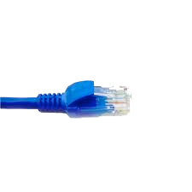
Let’s try out wireshark packet sniffer
application
(www browser,
email client)
packet
analyzer
application
OS
packet
capture
(pcap)
Transport (TCP/UDP)
Network (IP)
Link (Ethernet)
Physical
copy of all Ethernet frames sent/received

Slide 14

Looking ahead:
Sections 3.1 – 3.4 in textbook
Transport layer (still at the edge): multiplexing / demultiplexing, UDP, reliable data transfer (foundational material for TCP)

