Slide 1


Class website: http://kurose.cslash.net
kurose@cs.umass.edu
Today (10/13/20):
week in review
looking ahead

Slide 2








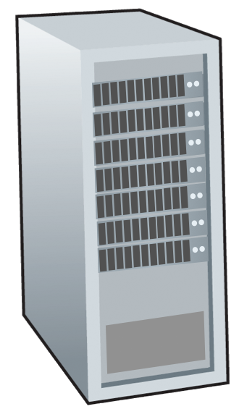







Where are we?
Still at the network “edge”:
finished application layer
  application-layer protocols: HTTP, DNS, SMTP
  application-layer distributed systems: streaming multimedia, DNS
  socket API
mobile network
national or global ISP
local or regional ISP
On to the transport layer:
reliable data transfer
congestion control
UDP, TCP
home network
content
provider
network
datacenter
network
enterprise
network

Slide 3

Week in review: multiplexing/demultiplexing
multiplexing at sender:
demultiplexing at receiver:
handle data from multiple
sockets, add transport header (later used for demultiplexing)
use header info to deliver
received segments to correct
socket
application
application
P1
P2
application
socket
P3
transport
P4
process
transport
network
transport
network
link
network
link
physical
link
physical
physical

Slide 4
Week in review: multiplexing/demultiplexing
host receives IP datagrams
  each datagram has source IP address, destination IP address, carries one transport-layer segment
  each segment has source, destination port number
32 bits
source port #
dest port #
other header fields
destination host uses
  UDP: demultiplexes using two values:
    (1) destination IP address, (2) dest port #
  TCP: uses a 4-tuple:
    (1) dest. IP address, (2) dest. port #
    (3) source IP address, (4) source port #
  to direct segment to appropriate socket
application
data
(payload)
TCP/UDP segment format

Slide 5
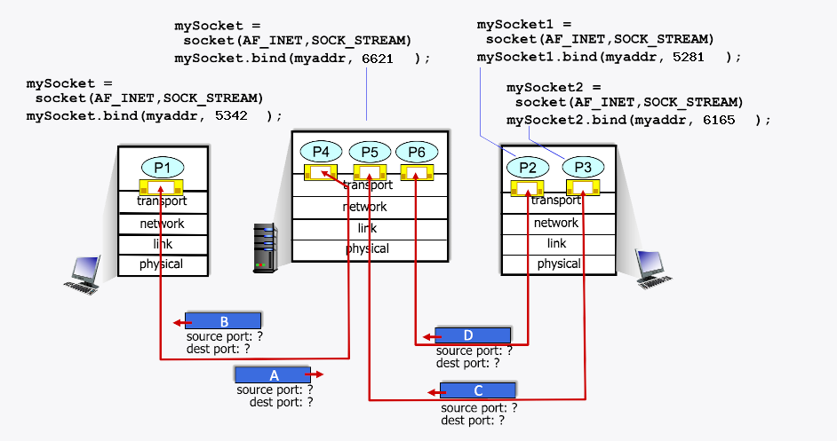
Week in review: multiplexing/demultiplexing
More examples at
http://gaia.cs.umass.edu/kurose_ross/interactive
JFK: do poll

Slide 6
Week in review: UDP
“no frills,” “bare bones” Internet transport protocol
“best effort” service, UDP segments may be:
  lost
  delivered out-of-order to app
source port #
dest port #
length
checksum
application
data
(payload)
connectionless:
  no handshaking between UDP sender, receiver
  each UDP segment handled independently of others
UDP segment format

Slide 7
Reliable data transfer with bit errors
underlying channel may flip bits in packet
  checksum to detect bit errors
the question: how to recover from errors?
  acknowledgements (ACKs): receiver explicitly tells sender that pkt received OK
  negative acknowledgements (NAKs): receiver explicitly tells sender that pkt had errors
  sender retransmits pkt on receipt of NAK
stop and wait
sender sends one packet, then waits for receiver response

Slide 8

rdt3.0: channels with errors and loss
Approach: sender waits “reasonable” amount of time for ACK
retransmits if no ACK received in this time
if packet (or ACK) just delayed (not lost):
    retransmission will be duplicate, use seq #s to detect duplicate !
    receiver must specify seq # of packet being ACKed
use countdown timer to interrupt after “reasonable” amount of time
timeout

Slide 9
RDT summary: mechanisms used
checksum: to detect bit-level errors errors
ACK/NACK: to let sender know what receive has received correctly
sequence numbers: to detect duplicate or missing messages at receiver
  receiver ACKs specify sequence numbers received
timer: timeout used by sender to transmit possibly lost messages
This is an important slide – understand why mechanisms are needed

Slide 10

rdt3.0 in action
sender
receiver
sender
receiver
send pkt0
pkt0
send pkt0
pkt0
rcv pkt0
rcv pkt0
ack0
send ack0
ack0
send ack0
rcv ack0
rcv ack0
send pkt1
pkt1
send pkt1
pkt1
rcv pkt1
X
ack1
send ack1
loss
rcv ack1
send pkt0
pkt0
rcv pkt0
timeout
resend pkt1
ack0
send ack0
pkt1
rcv pkt1
ack1
send ack1
rcv ack1
send pkt0
pkt0
(a) no loss
rcv pkt0
ack0
send ack0
(b) packet loss

Slide 11
rdt3.0 in action
sender
receiver
sender
receiver
send pkt0
pkt0
rcv pkt0
send pkt0
pkt0
send ack0
rcv pkt0
rcv ack0
ack0
ack0
send ack0
send pkt1
pkt1
rcv ack0
rcv pkt1
send pkt1
pkt1
send ack1
rcv pkt1
ack1
ack1
send ack1
X
timeout
resend pkt1
loss
pkt1
rcv pkt1
timeout
resend pkt1
rcv ack1
(detect duplicate)
pkt1
rcv pkt1
send ack1
send pkt0
pkt0
ack1
(detect duplicate)
rcv pkt0
rcv ack1
send ack1
rcv ack1
ack1
ack0
send ack0
send pkt0
pkt0
(ignore)
rcv pkt0
ack0
send ack0
pkt1
(c) ACK loss
(d) premature timeout/ delayed ACK

Slide 12
Performance of rdt3.0 (stop-and-wait)
  U _{sender}: utilization – fraction of time sender busy sending
example: 1 Gbps link, 15 ms prop. delay, 8000 bit packet
  time to transmit packet into channel:
L
8000 bits
D_{trans} =
=
=
8 microsecs
R
10⁹ bits/sec
Notes:
if RTT=30 msec, 1KB pkt every 30 msec: 33kB/sec thruput over 1 Gbps link
network protocol limits use of physical resources
Let’s develop a formula for utilization

Slide 13
rdt3.0: stop-and-wait operation
sender
receiver
first packet bit transmitted, t = 0
first packet bit arrives
RTT
last packet bit arrives, send ACK
ACK arrives, send next
packet, t = RTT + L / R

Slide 14
rdt3.0: stop-and-wait operation
sender
receiver
L / R
=
L/R
U_{sender}
RTT
+ L / R
.008
RTT
=
30.008
=
0.00027
rdt 3.0 protocol performance stinks!
Protocol limits performance of underlying infrastructure (channel)

Slide 15
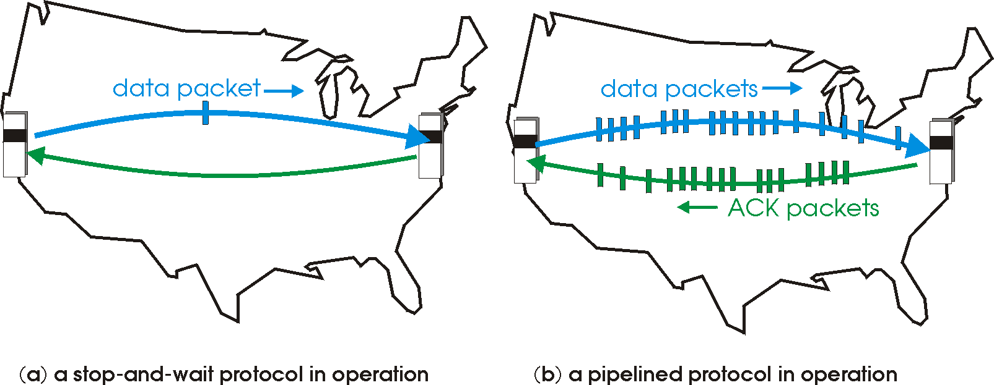
rdt3.0: pipelined protocols operation
pipelining: sender allows multiple, “in-flight”, yet-to-be-acknowledged packets
  range of sequence numbers must be increased
  buffering at sender and/or receiver

Slide 16
Pipelining: increased utilization
sender
receiver
first packet bit transmitted, t = 0
last bit transmitted, t = L / R
first packet bit arrives
RTT
last packet bit arrives, send ACK
last bit of 2nd packet arrives, send ACK
last bit of 3rd packet arrives, send ACK
ACK arrives, send next
packet, t = RTT + L / R
3-packet pipelining increases
utilization by a factor of 3!
Notes:
two generic forms of pipelined protocols: go-Back-N, selective repeat

Slide 17

Looking ahead:
Sections 3.5 – 3.8 in textbook
Transport layer: TCP data transfer, congestion control, TCP congestion control

