Slide 1
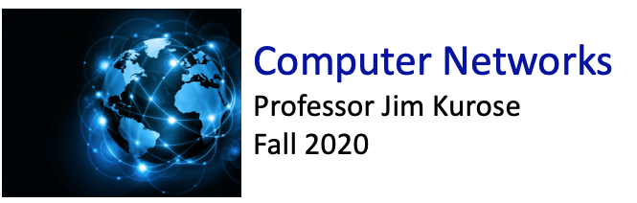

Class website: http://kurose.cslash.net
kurose@cs.umass.edu
Today (10/20/20):
week in review
looking ahead

Slide 2








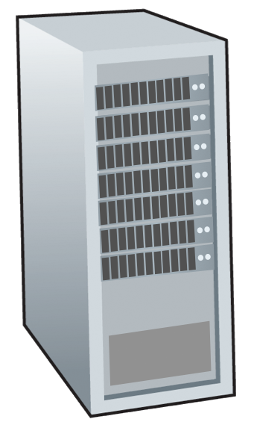







Where are we?
Still at the network “edge”:
Today:
TCP reliable data transfer
congestion control principles
TCP congestion control
mobile network
national or global ISP
local or regional ISP
home network
content
provider
network
datacenter
network
enterprise
network

Slide 3
TCP reliable data transfer mechanisms:
sender uses sequence numbers (counts bytes)
receiver sends positive ACKs
  cumulative ACKs: ACK(x) acknowledges all data up to x
  selective ACK (SACK) is an option
sender timeout / retransmit
3-way handshake used to establish reliability parameters (e.g., sequence numbers, flow control) before user data starts to flow
Notes:
This is how TCP re-computes the estimated RTT each time a new SampleRTT is taken.
The process is knows as an exponeitally weighted moving average, shown by the equation here.
<say it>
Where alpha reflects the influence of the most recent measurements on the estimated RTT; a typical value of alpha used in implementaitons is .125
The graph at the bottom show measured RTTs beween a host in the Massachusetts and a host in France, as well as the estimated, “smoothed” RTT

Slide 4
TCP round trip time, timeout
EstimatedRTT = (1- α)*EstimatedRTT + α*SampleRTT
exponential weighted moving average (EWMA)
influence of past sample decreases exponentially fast
typical value: α = 0.125
RTT: gaia.cs.umass.edu to fantasia.eurecom.fr
RTT (milliseconds)
sampleRTT
EstimatedRTT
time (seconds)
Notes:
This is how TCP re-computes the estimated RTT each time a new SampleRTT is taken.
The process is knows as an exponeitally weighted moving average, shown by the equation here.
<say it>
Where alpha reflects the influence of the most recent measurements on the estimated RTT; a typical value of alpha used in implementaitons is .125
The graph at the bottom show measured RTTs beween a host in the Massachusetts and a host in France, as well as the estimated, “smoothed” RTT

Slide 5

TCP round trip time, timeout
timeout interval: EstimatedRTT plus “safety margin”
  large variation in EstimatedRTT: want a larger safety margin
TimeoutInterval = EstimatedRTT + 4*DevRTT
estimated RTT
“safety margin”
DevRTT: EWMA of SampleRTT deviation from EstimatedRTT:
DevRTT = (1-β)*DevRTT + β*|SampleRTT-EstimatedRTT|
(typically, β = 0.25)
* Check out the online interactive exercises for more examples: http://gaia.cs.umass.edu/kurose_ross/interactive/
Notes:
Given this value of the estimated RTT, TCP computes the timeout interval to be the estimated RTT plus a “safety margin”
And the intuition is that if we are seeing a large variation in SAMPLERTT – the RTT estimates are fluctuating a lot - then we’ll want a larger savety margin
So TCP computes the Timeout interval to be the Estimated RTT plus 4 times a measure of deviation in the RTT.
The deviation in the RTT is computed as the eWMA of the difference between the most recently measured SampleRTT from the Estimated RTT

Slide 6

TCP flow control
application
process
Q: What happens if network layer delivers data faster than application layer removes data from socket buffers?
Application removing data from TCP socket buffers
TCP socket
receiver buffers
TCP
code
Network layer delivering IP datagram payload into TCP socket buffers
IP
code
from sender
receiver protocol stack
Notes:
(Presuming an intro)
Before diving into the details of TCP flow control, let’s first get the general context and motivate the need for flow control.
This diagram show a typical transport-layer implementation
A segment is brought up the protocol stack to the transport layer, and the segment’s payload is removed from the segment and written INTO socket buffers.
How does data get taken OUT of socket buffers? By applications performing socket reads, as we learned in Chapter 2.
And so the question is “What happens if network layer delivers data faster than an application-layer process removes data from socket buffers?”
Let’s watch a video of what happens when things arrive way too fast to fast to be processed.
<video>. (I love that video). Another human analogy showing the need for flow control is the saying – to use some English slang - “no one can drink from a firehose”
Flow control is a mechanism to the calamity of a receiver being over-run by a sender that is sending too fast – it allows the RECEIVER to explictly control the SENDER so sender won’t overflow receiver’s buffer by transmitting too much, too fast

Slide 7


TCP flow control
application
process
Q: What happens if network layer delivers data faster than application layer removes data from socket buffers?
Application removing data from TCP socket buffers
TCP socket
receiver buffers
TCP
code
Network layer delivering IP datagram payload into TCP socket buffers
IP
code
from sender
receiver protocol stack
Notes:
(Presuming an intro)
Before diving into the details of TCP flow control, let’s first get the general context and motivate the need for flow control.
This diagram show a typical transport-layer implementation
A segment is brought up the protocol stack to the transport layer, and the segment’s payload is removed from the segment and written INTO socket buffers.
How does data get taken OUT of socket buffers? By applications performing socket reads, as we learned in Chapter 2.
And so the question is “What happens if network layer delivers data faster than an application-layer process removes data from socket buffers?”
Let’s watch a video of what happens when things arrive way too fast to fast to be processed.
<video>. (I love that video). Another human analogy showing the need for flow control is the saying – to use some English slang - “no one can drink from a firehose”
Flow control is a mechanism to the calamity of a receiver being over-run by a sender that is sending too fast – it allows the RECEIVER to explictly control the SENDER so sender won’t overflow receiver’s buffer by transmitting too much, too fast

Slide 8
TCP flow control
application
process
Q: What happens if network layer delivers data faster than application layer removes data from socket buffers?
Application removing data from TCP socket buffers
TCP socket
receiver buffers
TCP
code
receive window
flow control: # bytes receiver willing to accept
IP
code
from sender
receiver protocol stack
Notes:
(Presuming an intro)
Before diving into the details of TCP flow control, let’s first get the general context and motivate the need for flow control.
This diagram show a typical transport-layer implementation
A segment is brought up the protocol stack to the transport layer, and the segment’s payload is removed from the segment and written INTO socket buffers.
How does data get taken OUT of socket buffers? By applications performing socket reads, as we learned in Chapter 2.
And so the question is “What happens if network layer delivers data faster than an application-layer process removes data from socket buffers?”
Let’s watch a video of what happens when things arrive way too fast to fast to be processed.
<video>. (I love that video). Another human analogy showing the need for flow control is the saying – to use some English slang - “no one can drink from a firehose”
Flow control is a mechanism to the calamity of a receiver being over-run by a sender that is sending too fast – it allows the RECEIVER to explictly control the SENDER so sender won’t overflow receiver’s buffer by transmitting too much, too fast

Slide 9
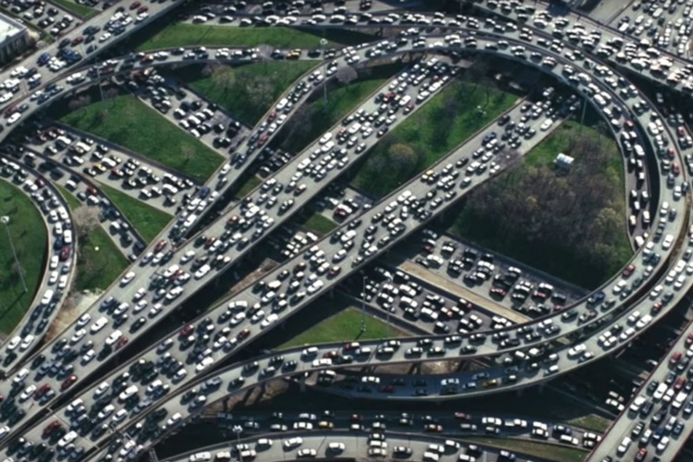
Principles of congestion control
Congestion:
informally: “too many sources sending too much data too fast for network to handle”
manifestations:
  long delays (queueing in router buffers)
  packet loss (buffer overflow at routers)
a top-10 problem!
network-assisted, end-end congestion control
congestion control: too many senders, sending too fast
flow control: one sender too fast for one receiver

Slide 10
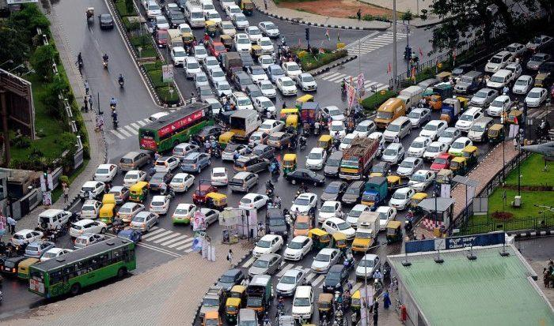

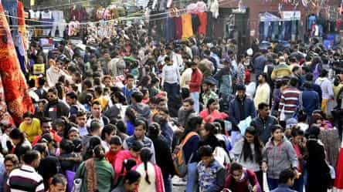
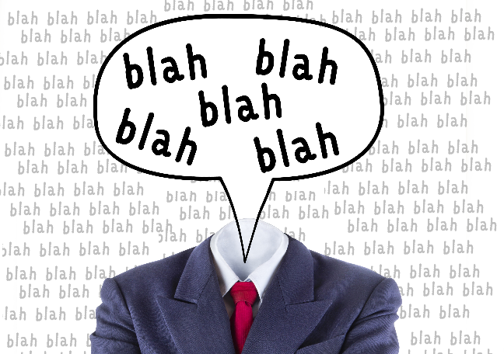
Principles of congestion control
Is congested control or flow control needed?
A
B
D
E
highway
glass overflowing
crowd in intersection
Person talking too much!
JFK: do poll

Slide 11
Approaches towards congestion control
End-end congestion control:
no explicit feedback from network
congestion inferred from observed loss, delay
ACKs
data
data
ACKs
approach taken by TCP

Slide 12
Approaches towards congestion control
Network-assisted congestion control:
routers provide direct feedback to sending/receiving hosts with flows passing through congested router
may indicate congestion level or explicitly set sending rate
explicit congestion info
ACKs
data
data
ACKs
TCP ECN, ATM, DECbit protocols

Slide 13
TCP congestion control: AIMD
approach: senders can increase sending rate until packet loss (congestion) occurs, then decrease sending rate on loss event
Additive Increase
Multiplicative Decrease
  increase sending rate by 1 maximum segment size every RTT until loss detected
  cut sending rate in half at each loss event
AIMD sawtooth
behavior: probing
for bandwidth
TCP sender Sending rate
time

Slide 14
TCP AIMD: more
Multiplicative decrease detail: sending rate is
Cut in half on loss detected by triple duplicate ACK (TCP Reno)
Cut to 1 MSS (maximum segment size) when loss detected by timeout
Why AIMD?
AIMD – a distributed, asynchronous algorithm – has been shown to:
  optimize congested flow rates network wide!
  have desirable stability and fairness properties

Slide 15
TCP slow start
Host A
Host B
when connection begins, increase rate exponentially until first loss event:
  initially cwnd = 1 MSS
  double cwnd every RTT
  done by incrementing cwnd for every ACK received
one segment
RTT
two segments
four segments
summary: initial rate is slow, but ramps up exponentially fast
time

Slide 16
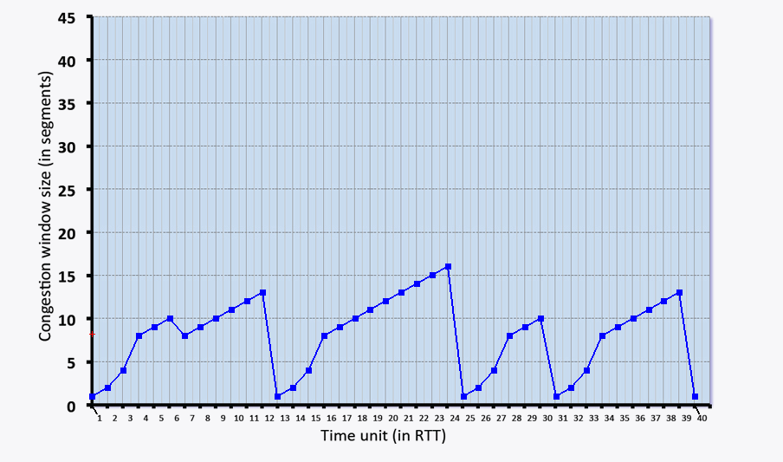
JFK: do poll
Identify intervals as:
slow start
congestion avoidance
loss

Slide 17
TCP fairness
Fairness goal: if K TCP sessions share same bottleneck link of bandwidth R, each should have average rate of R/K
TCP connection 1
bottleneck
router
capacity R
TCP connection 2

Slide 18
Q: is TCP Fair?
Example: two competing TCP sessions:
additive increase gives slope of 1, as throughout increases
multiplicative decrease decreases throughput proportionally
R
equal bandwidth share
Is TCP fair?
A: Yes, under idealized assumptions:
same RTT
fixed number of sessions only in congestion avoidance
loss: decrease window by factor of 2
congestion avoidance: additive increase
Connection 2 throughput
loss: decrease window by factor of 2
congestion avoidance: additive increase
Connection 1 throughput
R

Slide 19

Looking ahead:
Sections 4.1 – 4.3 in textbook
Network layer:
  What’s inside a router?
  Internet protocol (IP)

