Slide 1
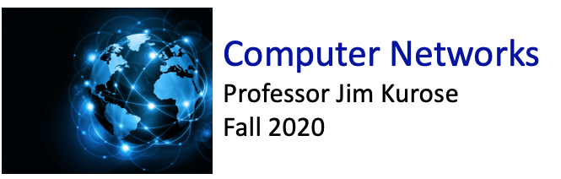

Class website: http://kurose.cslash.net
kurose@cs.umass.edu
Today (10/27/20):
week in review
looking ahead

Slide 2








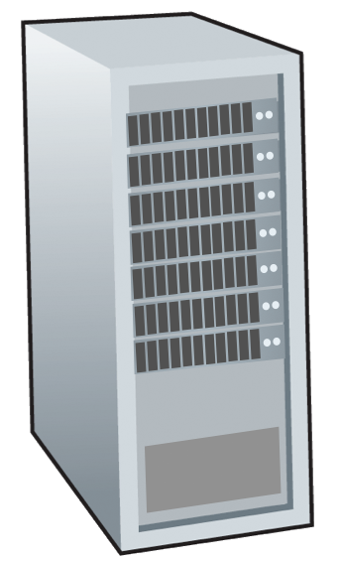







We’re in the network layer!
service: transport segment from sending to receiving host
network layer protocols in every Internet device: hosts, routers
routers:
  examines header fields in all IP datagrams passing through it
  moves datagrams from input ports to output ports to transfer datagrams along end-end path
mobile network
national or global ISP
application
transport
network
link
physical
network
link
physical
network
link
physical
network
link
physical
network
link
physical
network
link
physical
datacenter
network
application
transport
network
link
physical
enterprise
network

Slide 3
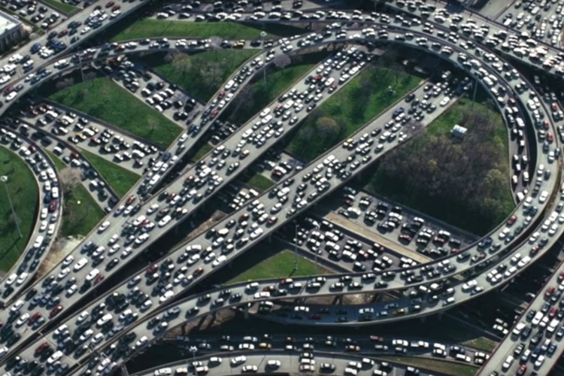
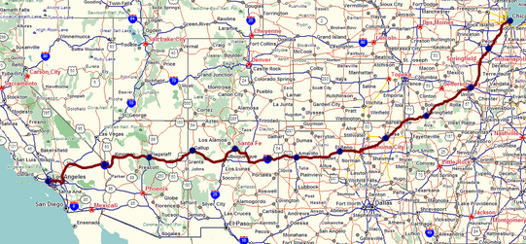
Two key network-layer functions
network-layer functions:
forwarding: move packets from a router’s input link to appropriate router output link
analogy: taking a trip
forwarding: process of getting through single interchange
routing: process of planning trip from source to destination
routing: determine route taken by packets from source to destination
  routing algorithms
forwarding
routing

Slide 4
Network layer: data plane, control plane
Data plane:
local, per-router function
determines how datagram arriving on router input port is forwarded to router output port
Control plane
network-wide logic
determines how datagram is routed among routers along end-end path from source host to destination host
values in arriving
packet header
two control-plane approaches:
  traditional routing algorithms: implemented in routers
  software-defined networking (SDN): implemented in (remote) servers
0111
1
3
2

Slide 5

Network layer: “data plane” roadmap
Network layer: overview
  data plane
  control plane
What’s inside a router
  input ports, switching, output ports
  buffer management, scheduling
IP: the Internet Protocol
  datagram format
  addressing
  network address translation
  IPv6
Generalized Forwarding, SDN
  Match+action
  OpenFlow: match+action in action
Middleboxes

Slide 6

Per-router control plane
Individual routing algorithm components in each and every router interact in the control plane
Routing
Algorithm
control
plane
data
plane
values in arriving
packet header
0111
1
3
2

Slide 7
Software-Defined Networking (SDN) control plane
Remote controller computes, installs forwarding tables in routers
Remote Controller
control
plane
data
plane
CA
CA
CA
CA
CA
values in arriving
packet header
0111
1
3
2

Slide 8
Router architecture overview
high-level view of generic router architecture:
routing, management
control plane (software)
operates in millisecond
time frame
routing
processor
forwarding data plane (hardware) operates in nanosecond timeframe
high-speed
switching
fabric
router input ports
router output ports

Slide 9
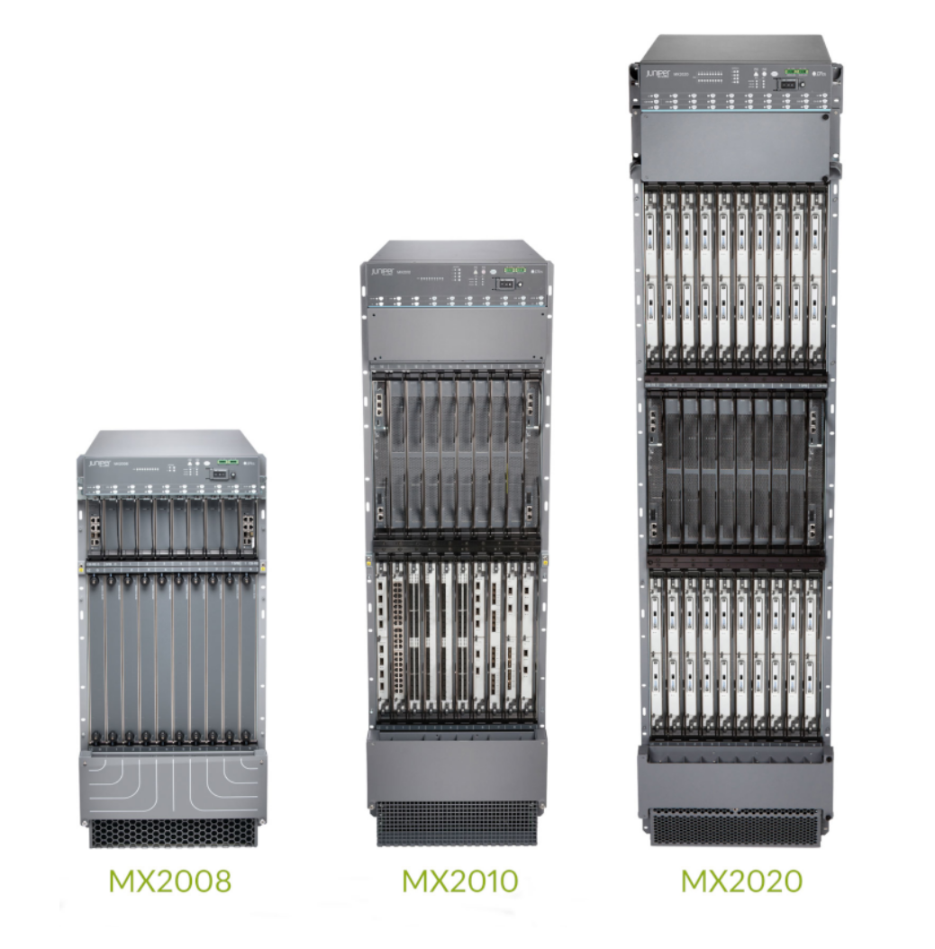
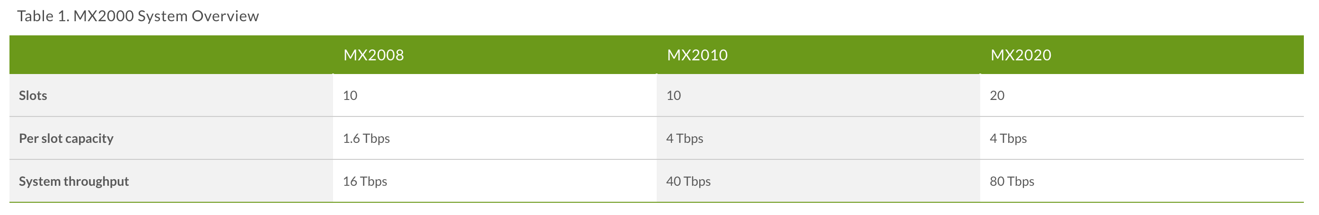
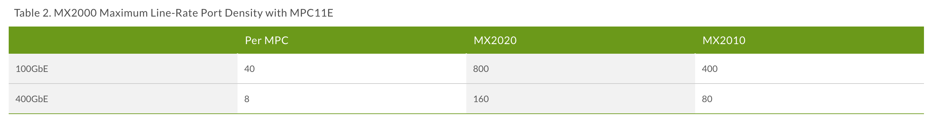
Juniper MX 2020

Slide 10
Switching fabrics
transfer packet from input link to appropriate output link
switching rate: rate at which packets can be transfer from inputs to outputs
  often measured as multiple of input/output line rate
  N inputs: switching rate N times line rate desirable
R
(rate: NR, ideally)
R
. . .
high-speed
switching
fabric
. . .
N input ports
N output ports
R
R

Slide 11
Input port functions
lookup,
forwarding
queueing
line
termination
link
layer
protocol
(receive)
switch
fabric
physical layer:
bit-level reception
decentralized switching:
using header field values, lookup output port using forwarding table in input port memory (“match plus action”)
destination-based forwarding: forward based only on destination IP address (traditional)
generalized forwarding: forward based on any set of header field values
link layer:
e.g., Ethernet
(chapter 6)

Slide 12

Output port queuing
datagram
buffer
queueing
This is a really important slide
switch
fabric
(rate: NR)
link
layer
protocol
(send)
line
termination
R
Buffering required when datagrams arrive from fabric faster than link transmission rate. Drop policy: which datagrams to drop if no free buffers?
Datagrams can be lost due to congestion, lack of buffers
Scheduling discipline chooses among queued datagrams for transmission
Priority scheduling – who gets best performance, network neutrality

Slide 13
Packet Scheduling: FCFS
packet scheduling: deciding which packet to send next on link
  first come, first served
  priority
  round robin
  weighted fair queueing
FCFS: packets transmitted in order of arrival to output port
also known as: First-in-first-out (FIFO)
real world examples?
Abstraction: queue
R
packet
departures
packet
arrivals
queue
(waiting area)
link
(server)

Slide 14
Scheduling policies: priority
Priority scheduling:
arriving traffic classified, queued by class
  any header fields can be used for classification
high priority queue
arrivals
classify
link
departures
low priority queue
2
send packet from highest priority queue that has buffered packets
  FCFS within priority class
1
3
4
5
arrivals
packet in service
1
3
2
4
5
departures
1
3
2
4
5
JFK: poll

Slide 15
Sidebar: Network Neutrality
What is network neutrality?
  technical: how an ISP should share/allocation its resources
  packet scheduling, buffer management are the mechanisms
  social, economic principles
    protecting free speech
    encouraging innovation, competition
  enforced legal rules and policies
Different countries have different “takes” on network neutrality

Slide 16
Sidebar: Network Neutrality
2015 US FCC Order on Protecting and Promoting an Open Internet: three “clear, bright line” rules:
no blocking … “shall not block lawful content, applications, services, or non-harmful devices, subject to reasonable network management.”
no throttling … “shall not impair or degrade lawful Internet traffic on the basis of Internet content, application, or service, or use of a non-harmful device, subject to reasonable network management.”
no paid prioritization. … “shall not engage in paid prioritization”

Slide 17
ISP: telecommunications or information service?
Is an ISP a “telecommunications service” or an “information service” provider?
the answer really matters from a regulatory standpoint!
US Telecommunication Act of 1934 and 1996:
  Title II: imposes “common carrier duties” on telecommunications services: reasonable rates, non-discrimination and requires regulation
  Title I: applies to information services:
    no common carrier duties (not regulated)
    but grants FCC authority “… as may be necessary in the execution of its functions”4

Slide 18
Network Layer: Internet
host, router network layer functions:
transport layer: TCP, UDP
IP protocol
datagram format
addressing
packet handling conventions
Path-selection algorithms: implemented in
routing protocols (OSPF, BGP)
SDN controller
network
layer
forwarding
table
ICMP protocol
error reporting
router “signaling”
link layer
physical layer

Slide 19
IP Datagram format
32 bits
IP protocol version number
head.
len
type of
service
total datagram
length (bytes)
ver
length
header length(bytes)
“type” of service:
diffserv (0:5)
ECN (6:7)
flgs
fragment
offset
fragmentation/
reassembly
16-bit identifier
time to
live
upper
layer
header
checksum
header checksum
TTL: remaining max hops
(decremented at each router)
source IP address
32-bit source IP address
destination IP address
Maximum length: 64K bytes
Typically: 1500 bytes or less
upper layer protocol (e.g., TCP or UDP)
32-bit destination IP address
overhead
options (if any)
e.g., timestamp, record route taken
20 bytes of TCP
20 bytes of IP
= 40 bytes + app layer overhead for TCP+IP
payload data
(variable length,
typically a TCP
or UDP segment)

Slide 20

Looking ahead:
sections 4.3.1 – 5.1 in textbook
network layer:
  finish up data plane
  start control plane

