Slide 1
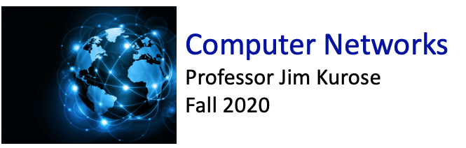

Class website: http://kurose.cslash.net
kurose@cs.umass.edu
Today (11/8/20):
week in review
  generalized forwarding
  middleboxes, internet architecture
looking ahead

Slide 2
Flow table abstraction
flow: defined by header field values (in link-, network-, transport-layer fields)
generalized forwarding: simple packet-handling rules
  match: pattern values in packet header fields
  actions: for matched packet: drop, forward, modify, matched packet or send matched packet to controller
  priority: disambiguate overlapping patterns
  counters: #bytes and #packets
Flow table
Router’s flow table define router’s match+action rules
match
action

Slide 3
Flow table abstraction
flow: defined by header fields
generalized forwarding: simple packet-handling rules
  match: pattern values in packet header fields
  actions: for matched packet: drop, forward, modify, matched packet or send matched packet to controller
  priority: disambiguate overlapping patterns
  counters: #bytes and #packets
src = *.*.*.*, dest=3.4.*.* forward(2)
Flow table
match
action
src=1.2.*.*, dest=*.*.*.* drop
src=10.1.2.3, dest=*.*.*.* send to controller
* : wildcard
1
4
3
2

Slide 4
OpenFlow: flow table entries
Match
Action
Stats
Packet + byte counters
Forward packet to port(s)
Drop packet
Modify fields in header(s)
Encapsulate and forward to controller
Header fields to match:
Ingress Port
Src MAC
Dst MAC
Eth Type
VLAN
ID
VLAN
Pri
IP Src
IP Dst
IP Proto
IP
ToS
TCP/UDP Src Port
TCP/UDP Dst Port
Link layer
Network layer
Transport layer

Slide 5
OpenFlow: examples
Destination-based forwarding:
Switch
Port
MAC
src
MAC
dst
Eth
type
VLAN
ID
VLAN
Pri
IP
Src
IP
Dst
IP
Prot
IP
ToS
TCP
s-port
TCP
d-port
Action
*
*
*
*
*
*
*
51.6.0.8
*
*
*
*
port6
IP datagrams destined to IP address 51.6.0.8 should be forwarded to router output port 6
Firewall:
Switch
Port
MAC
src
MAC
dst
Eth
type
VLAN
ID
VLAN
Pri
IP
Src
IP
Dst
IP
Prot
IP
ToS
TCP
s-port
TCP
d-port
Action
*
*
*
*
*
*
*
*
*
*
*
22
drop
Block (do not forward) all datagrams destined to TCP port 22 (ssh port #)
Switch
Port
MAC
src
MAC
dst
Eth
type
VLAN
ID
VLAN
Pri
IP
Src
IP
Dst
IP
Prot
IP
ToS
TCP
s-port
TCP
d-port
Action
*
*
*
*
*
*
128.119.1.1
*
*
*
*
*
drop
Block (do not forward) all datagrams sent by host 128.119.1.1

Slide 6


OpenFlow example
match
action
Orchestrated tables can create network-wide behavior, e.g.,:
datagrams from hosts h5 and h6 should be sent to h3 or h4, via s1 and from there to s2
IP Src = 10.3.*.*
IP Dst = 10.2.*.*
Host h6
10.3.0.6
forward(3)
1
s3
controller
2
3
4
Host h5
10.3.0.5
1
s1
s2
Host h1
10.1.0.1
1
2
Host h4
10.2.0.4
4
2
4
3
3
match
action
match
action
Host h2
10.1.0.2
Host h3
10.2.0.3
ingress port = 2
IP Dst = 10.2.0.3
ingress port = 2
IP Dst = 10.2.0.4
ingress port = 1
IP Src = 10.3.*.*
IP Dst = 10.2.*.*
forward(3)
forward(4)
forward(4)

Slide 7
The IP hourglass
HTTP
SMTP
RTP
…
Internet’s “thin waist”:
one network layer protocol: IP
must be implemented by every (billions) of Internet-connected devices
QUIC
DASH
many protocols in physical, link, transport, and application layers
TCP
UDP
IP
Ethernet
…
PPP
PDCP
WiFi
Bluetooth
copper radio fiber
Q: what is the architectural waist of other large scale systems (e.g., railroad)?

Slide 8
The IP hourglass, at middle age
HTTP
SMTP
RTP
…
QUIC
DASH
Internet’s middle age “love handles”?
middleboxes, operating inside the network
TCP
UDP
caching
NAT
IP
NFV
Firewalls
Ethernet
…
PPP
PDCP
WiFi
Bluetooth
copper radio fiber

Slide 9
Architectural Principles of the Internet
RFC 1958
“Many members of the Internet community would argue that there is no architecture, but only a tradition, which was not written down for the first 25 years (or at least not by the IAB). However, in very general terms, the community believes that
the goal is connectivity, the tool is the Internet Protocol, and the intelligence is end to end rather than hidden in the network.”
Three cornerstone beliefs:
simple connectivity
IP protocol: that narrow waist
intelligence, complexity at network edge

Slide 10
Network-layer functions
forwarding: move packets from router’s input to appropriate router output
data plane
routing: determine route taken by packets from source to destination
control plane
Two approaches to structuring network control plane:
per-router control (traditional)
logically centralized control (software defined networking)

Slide 11

Per-router control plane
Individual routing algorithm components in each and every router interact in the control plane
Routing
Algorithm
control
plane
data
plane
values in arriving
packet header
0111
1
3
2

Slide 12
Software-Defined Networking (SDN) control plane
Remote controller computes, installs forwarding tables in routers
Remote Controller
control
plane
data
plane
CA
CA
CA
CA
CA
values in arriving
packet header
0111
1
3
2

Slide 13








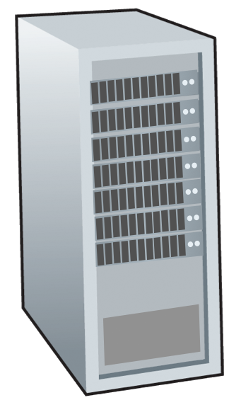







Routing protocols
mobile network
Routing protocol goal: determine “good” paths (equivalently, routes), from sending hosts to receiving host, through network of routers
path: sequence of routers packets traverse from given initial source host to final destination host
“good”: least “cost”, “fastest”, “least congested”
routing: a “top-10” networking challenge!
national or global ISP
application
transport
network
link
physical
network
link
physical
network
link
physical
network
link
physical
network
link
physical
network
link
physical
datacenter
network
application
transport
network
link
physical
enterprise
network

Slide 14
Graph abstraction: link costs
5
c_{a,b}: cost of direct link connecting a and b
e.g., c_{w,z} = 5, c_{u,z} = ∞
  cost defined by network operator: could always be 1, or inversely related to bandwidth, or inversely related to congestion
v
3
w
2
5
u
2
1
z
3
1
2
x
y
1
graph: G = (N,E)
N: set of routers = { u, v, w, x, y, z }
E: set of links ={ (u,v), (u,x), (v,x), (v,w), (x,w), (x,y), (w,y), (w,z), (y,z) }

Slide 15
Routing algorithm classification
global: all routers have complete topology, link cost info
“link state” algorithms
dynamic: routes change more quickly
  periodic updates or in response to link cost changes
How fast do routes change?
static: routes change slowly over time
decentralized: iterative process of computation, exchange of info with neighbors
routers initially only know link costs to attached neighbors
“distance vector” algorithms
global or decentralized information?

Slide 16

Looking ahead:
routing algorithms, protocols (OSPF, IS-IS, BGP)
SDN
network management

